Slide 1
Unit Testing – xUnit.net and MOQ (mock)
Basics for unit testing your web application in ASP.NET Core using xUnit and MOQ frameworks

Slide 2
What is Unit Testing?
Unit testing is the process through which units of source code are tested to verify if they work properly. ... Modern unit testing frameworks are typically implemented using the same code used by the system under test. This enables a developer who is writing application code in C# to write their unit tests in C# as well.
In computer programming, a unit test is a procedure used to verify that a particular module of source code is working properly. The idea about unit tests is to write test cases for all functions and methods so that whenever a change causes a regression, it can be quickly identified and fixed. Ideally, each test case is separate from the others; constructs such as mock objects can assist in separating unit tests. This type of testing is mostly done by the developers and not by end-users.

Slide 3
Terms for Quality Problems
Error- a mistake made by a human (in a software development activity)
Defect (or Fault) - the result of introducing an error into a software artifact (SRS, SDS, code, etc.)
Failure- a departure from the required behavior for a system

Slide 4
Testing Fundamentals
Software Testing is a critical element of Software Quality Assurance
It represents the ultimate review of the requirements specification, the design, and the code.
It is the most widely used method to insure software quality.
Many organizations spend 40-50% of development time in testing.
Testing is concerned with establishing the presence of program defects.
Debugging is concerned with finding where defects occur (in code, design or requirements) and removing them. (fault identification and removal)
Even if the best review methods are used (throughout the entire development of software), testing is necessary.
Testing is the one step in software engineering process that could be viewed as destructive rather than constructive.
“A successful test is one that breaks the software.”
A successful test is one that uncovers an as yet undiscovered defect.
Testing can not show the absence of defects, it can only show that software defects are present.

Slide 5
Testing Steps
Unit
test
Design
specifications
System
functional
requirements
Other
software
requirements
Customer
requirements
specification
User
environment
Unit code
Unit
test
Unit code
.
.
.
Integration
test
Functional
test
Performance
test
Acceptance
test
Installation
test
Unit
test
Integrated
modules
Functioning
system
Verified,
validated
software
Accepted
system
Unit code
SYSTEM
IN USE!

Slide 6
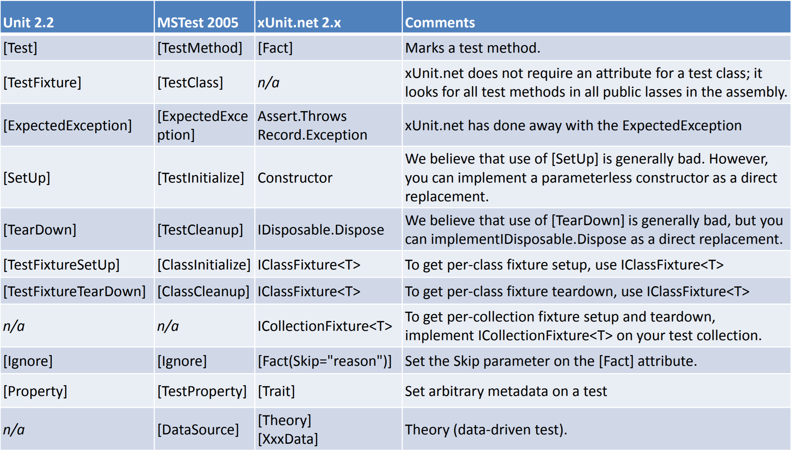
Comparing xUnit.net to other frameworks

Slide 7
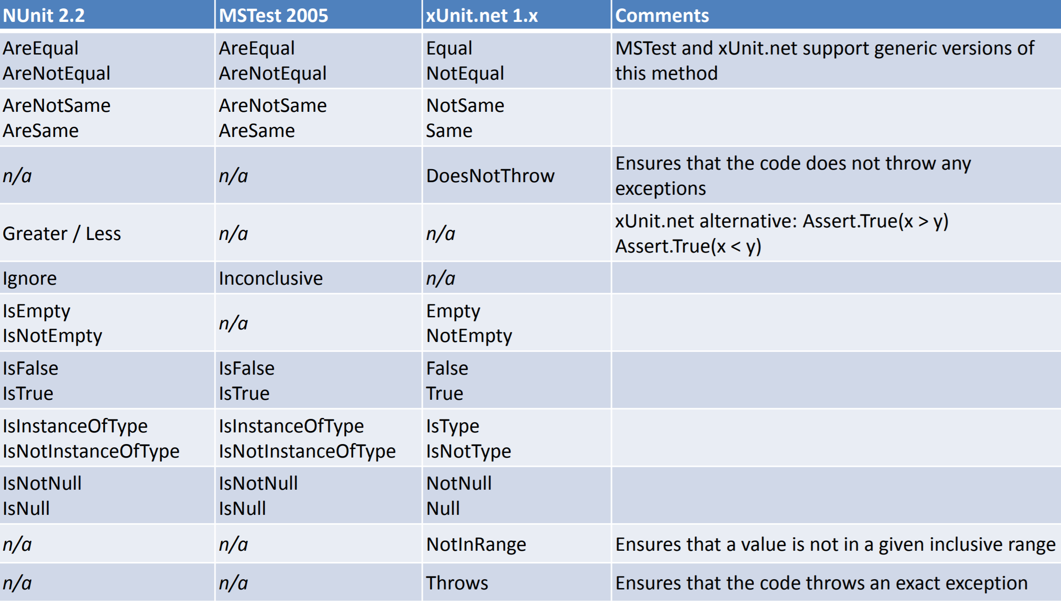
Comparing xUnit.net to other frameworks

Slide 8
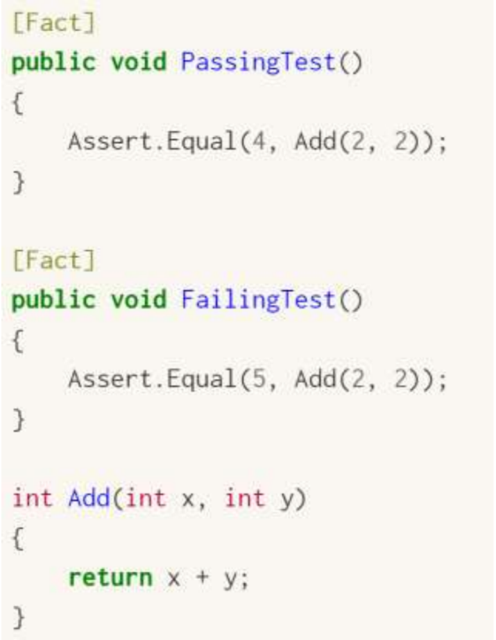
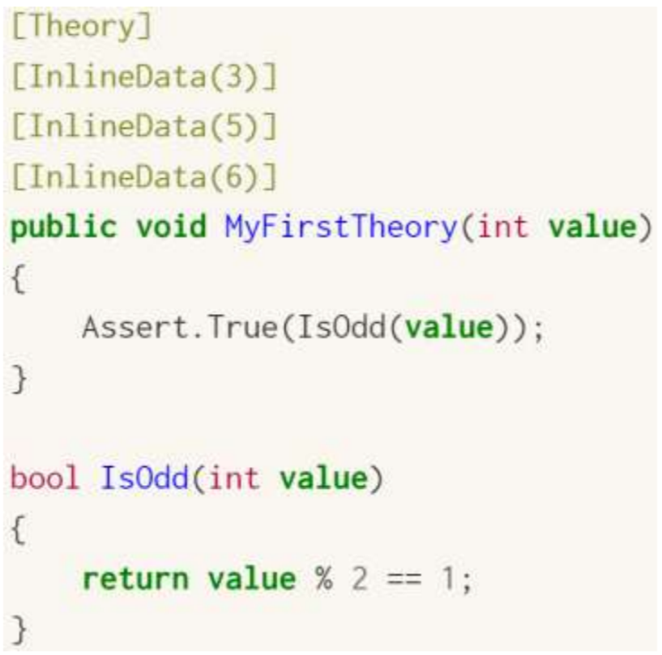
Two different major types of unit tests
Facts are tests which are always true. They test invariant conditions.
Theories are tests which are only true for a particular set of data (Data Driven Tests)

Slide 9
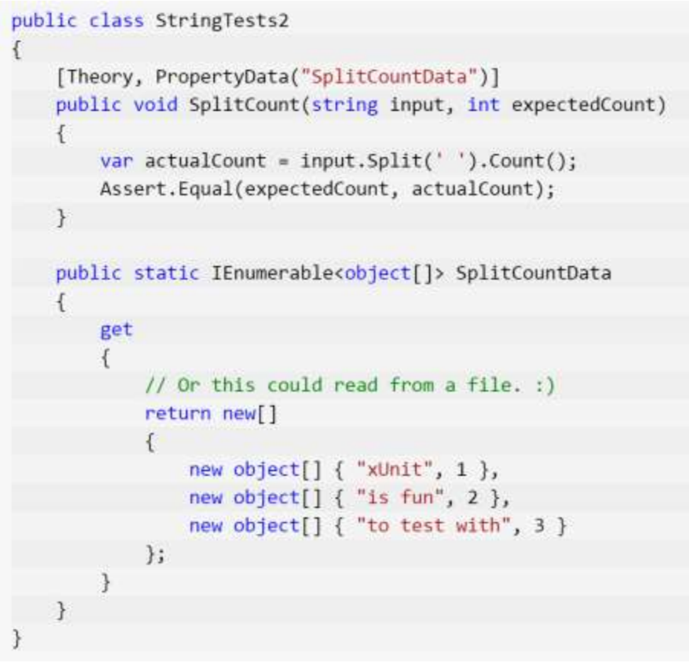
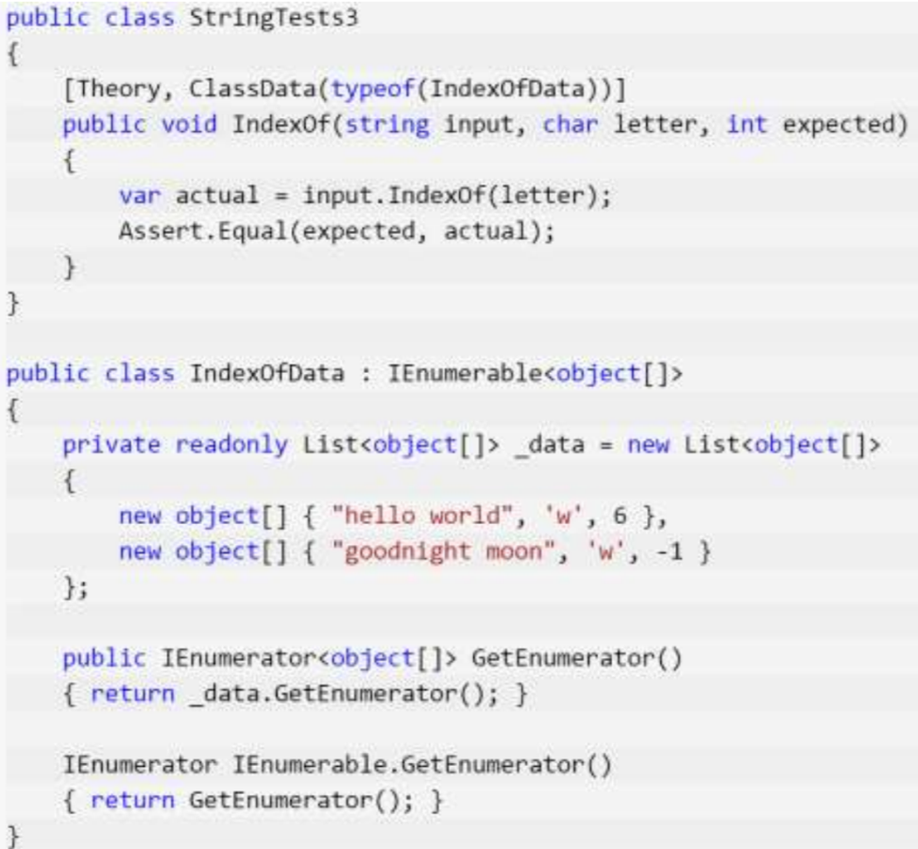
More data sources for theories
PropertyData
ClassData

Slide 10
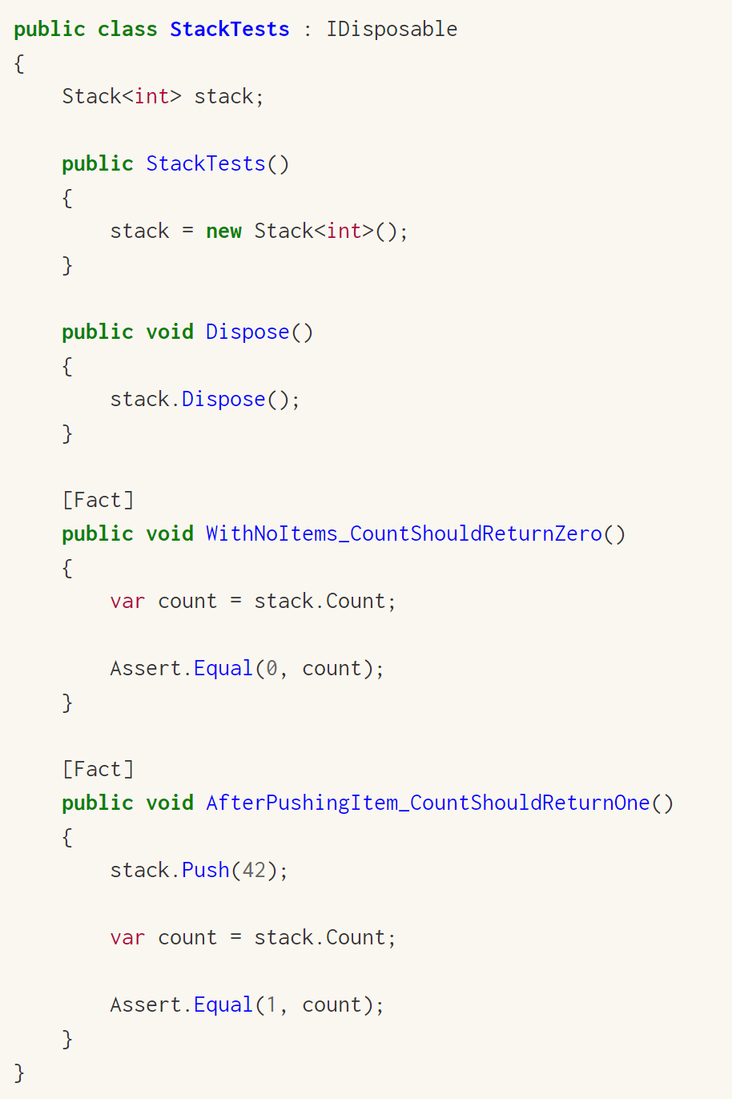
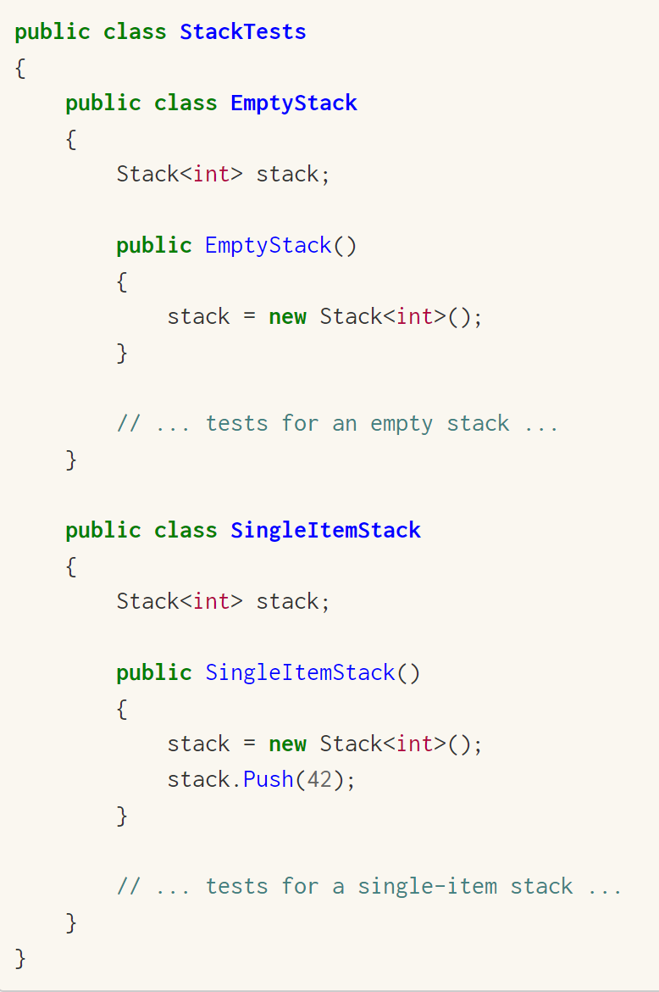
Shared Context between Tests Constructor and Dispose shared setup/cleanup code without sharing object instances
xUnit.net creates a new instance of the test class for every test that is run, so any code which is placed into the constructor of the test class will be run for every single test. This makes the constructor a convenient place to put reusable context setup code where you want to share the code without sharing object instances (meaning, you get a clean copy of the context object(s) for every test that is run).

Slide 11
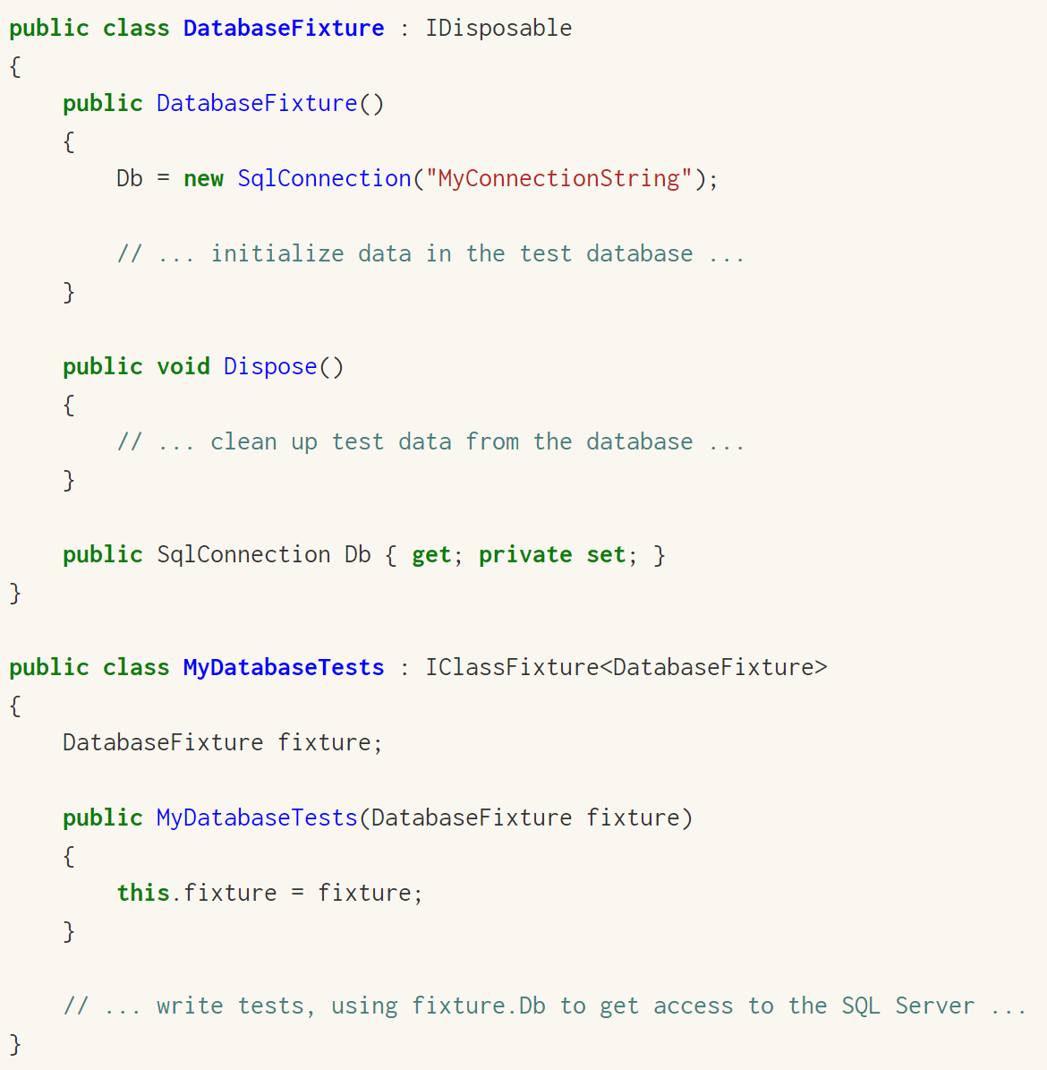
Shared Context between Tests Class Fixtures shared object instance across tests in a single class
To use class fixtures, you need to take the following steps:
Create the fixture class, and put the startup code in the fixture class constructor.
If the fixture class needs to perform cleanup, implement IDisposable on the fixture class, and put the cleanup code in the Dispose() method.
Add IClassFixture<> to the test class.
If the test class needs access to the fixture instance, add it as a constructor argument, and it will be provided automatically.
Sometimes test context creation and cleanup can be very expensive. If you were to run the creation and cleanup code during every test, it might make the tests slower than you want. You can use the class fixture feature of xUnit.net to share a single object instance among all tests in a test class.

Slide 12
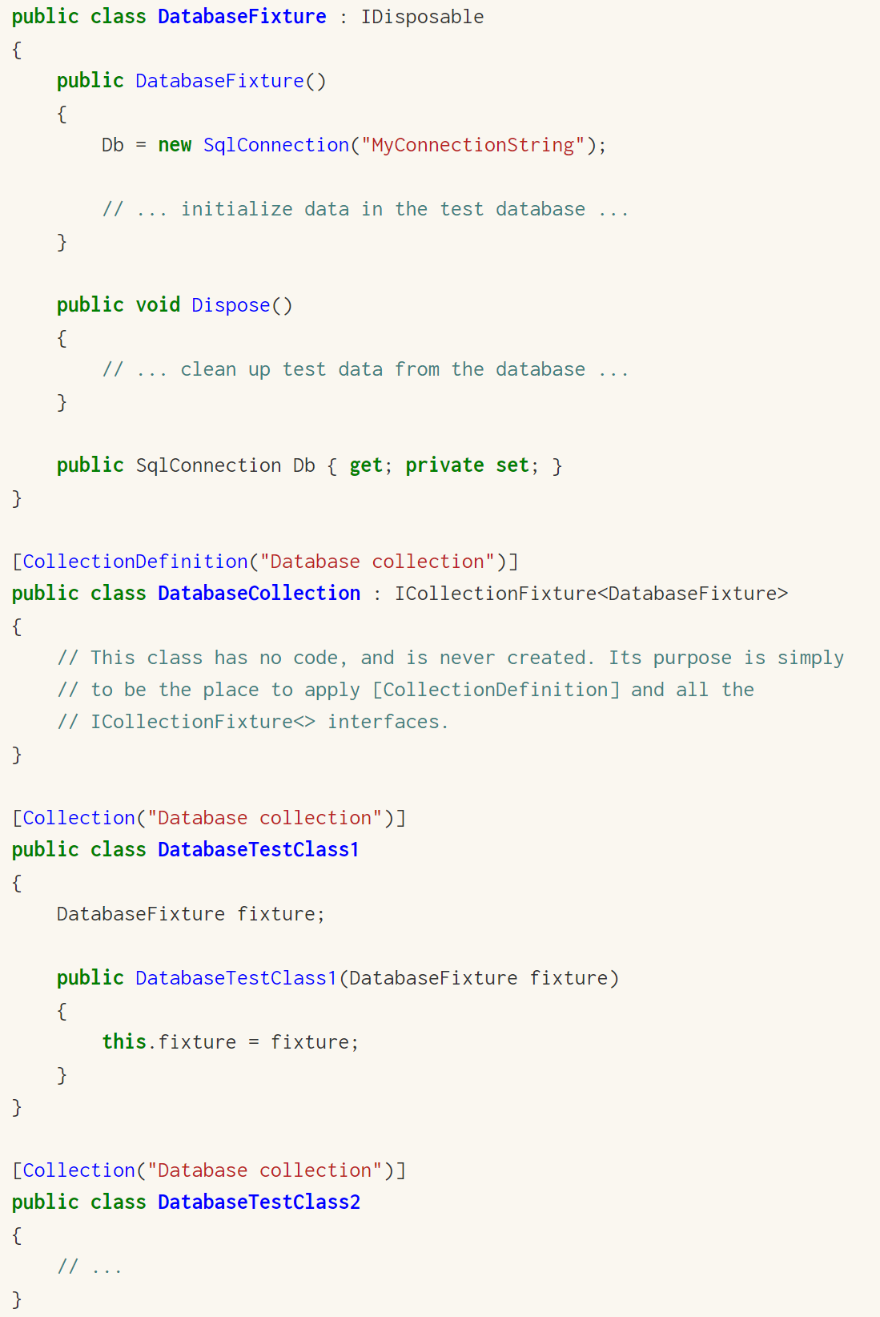
Shared Context between Tests Collection Fixtures shared object instances across multiple test classes
To use collection fixtures, you need to take the following steps:
Create the fixture class, and put the startup code in the fixture class constructor.
If the fixture class needs to perform cleanup, implement IDisposable on the fixture class, and put the cleanup code in the Dispose() method.
Create the collection definition class, decorating it with the [CollectionDefinition] attribute, giving it a unique name that will identify the test collection.
Add ICollectionFixture<> to the collection definition class.
Add the [Collection] attribute to all the test classes that will be part of the collection, using the unique name you provided to the test collection definition class's [CollectionDefinition] attribute.
If the test classes need access to the fixture instance, add it as a constructor argument, and it will be provided automatically.
Sometimes you will want to share a fixture object among multiple test classes. The database example used for class fixtures is a great example: you may want to initialize a database with a set of test data, and then leave that test data in place for use by multiple test classes. You can use the collection fixture feature of xUnit.net to share a single object instance among tests in several test class.

Slide 13
xUnit Extensibility
Assert (Sample: AssertExtensions )
Use 3rd party assertions or create custom
Before/After (Sample : UseCulture)
Run code before & after each test runs
Class Fixtures (Sample : ClassFixtureExample)
Run code before & after all tests in test class
Collection Fixtures (Sample: CollectionFixtureExample )
Run code before & after all tests in test collection
Theory Data (Sample: ExcelDataExample )
Provide new DataAttribute
Test Ordering (Sample: TestOrderExamples)
Traits (Sample: TraitExtensibility)
FactAttribute (Sample: TheoryAttribute)
What does it mean to be a test?
Test frameworks
What does it mean to find and run tests?
Runners

Slide 14
Unit Under Test May Call Many Dependencies
Unit (Class or Method)
Under Test
Dependency 1
Dependency 2
Dependency 3
ClassA
ClassB
ClassC
ClassD
ClassE
ClassF
ClassG
ClassH
ClassI
ClassJ
ClassK
ClassL
ClassM
ClassN
Database
Network
File System
Printer
Logger

Slide 15
Replace Dependencies with Mocks This reduces amount of code under test to just one class or method
Unit (Class or Method)
Under Test
Dependency 1 Mock
Dependency 2
Mock
Dependency 3
Mock

Slide 16
MOQ - Mocking your dependencies
Moq is a mocking framework for C#/.NET. It is used in unit testing to isolate your class under test from its dependencies and ensure that the proper methods on the dependent objects are being called.
In Unit Testing, we do not want to use “real” dependencies, this is what is called integration testing. So, we create “fake” dependencies that we setup to return exactly what we want. This way we can isolate the code under test (unit under test) to ensure we are only testing that code, and nothing more.

Slide 17
Why use Moq?
Isolate code under test; less fragile tests
Difficult to set up dependencies
Verify interaction between objects
Side effects (sending emails, launching missiles)
Abnormal situations (network outages, disk full)
Multiple dev streams (actual class doesn’t exist)
Non-deterministic results (timezones)
Real code too slow (trips to database)
Real code interacts with user (i.e. UI)

Slide 18
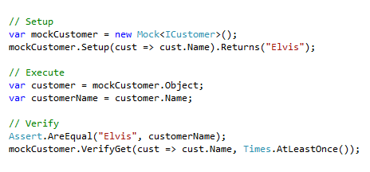
Moq Basic Syntax
In the above Moq, we are creating “Mock” customer that when we check for the cust.Name it will return “Elvis”.
Then we are testing to ensure that our mock returns the correct “Elvis” name, then using the mock object to verify the “get” method on the property.
This extra step is done because we can have code inside our getters that modifies the value. Such as “forgetting” to set a return value in our getter method.

Slide 19
Unit Test Best Practices
Write tests using the 3A patter
Arrange, Act, Assert
In other words, setup the test scenario, call the code under test, then check the results of the test after code execution.
Keep Your Tests Close to production code.
Ensure development emulates production as closely as possible for consistent stability across all environments.
Use Alternatives to ExpectedException
This leads to uncertainty, violates AAA
Use Small Fixtures
Smaller & more focused test classes
It is better to have many small tests, than one large test.
Don’t use SetUp/TearDown, TestInit/TestCleanup, etc…
Improve readability & isolation
Don’t use abstract base test classes
Improve readability & isolation
Improve testability with Inversion of Control
Better test isolation & decoupled class implementation

